Slide 1

IBM Project Presentation
on
Movie Review Sentiment Analysis - using Modern Architecture
By
Group ID – 31
Team Members name & Enrolment No
Patel Maharshi (23162172007)
Nitish Marker (23162582009)
Bhavin patel(23162582002)
Under the guidance of
Dr Sheetal pandya / Mr Palwinder Singh
Institute of computer technology
Date - 21-2-2026

Slide 2
Table of contex
Introduction
Scope of project
Project objective
System Architecture
Module Description
Advantages
Conclusion

Slide 3
Introduction
Bridging the Gap: From Text to Data
User-Centric Design: A complete ecosystem for movie enthusiasts to register, explore, and share opinions.
Smart Sentiment Analysis: Eliminates manual rating bias by using AI to objectively quantify the "mood" of a written review.
Automated Scoring: Instantaneous generation of a 1–10 scale rating, providing immediate visual feedback for the community.

Slide 4
Scope of project
Model Integration: Development of a middleware layer to connect pre-trained Machine Learning models with a front-end interface.
Automated Insights: Implementation of logic to translate raw model outputs into human-readable data visualizations and reports.
Real-time Processing: Ensuring the web interface can handle asynchronous requests to provide near-instant feedback from ML models.

Slide 5
Project Objectives
Intelligent Web Integration: Seamlessly bridging the gap between Machine Learning models and interactive web interfaces to drive automated insights.
Enterprise-Grade Security: Establishing a robust, multi-layer authentication framework to ensure user data integrity and privacy.
Structured Data Excellence: Leveraging relational database architecture for high-performance storage and complex data retrieval.
Tailored User Journeys: Delivering a dynamic, personalized dashboard experience designed to increase user engagement and retention.

Slide 6
System Architecture
Request Entry: The User interacts with the Flask-based frontend, initiating a secure session through the Auth Layer.
Data Processing: User reviews are passed to the AI Pipeline, where raw text is converted into numerical vectors and scored by the Rating Model.
Synchronization: The application fetches external metadata via OMDb API and merges it with internal user data.
Persistence: All interactions, scores, and metadata are committed to the Relational Database via the SQLAlchemy ORM.

Slide 7
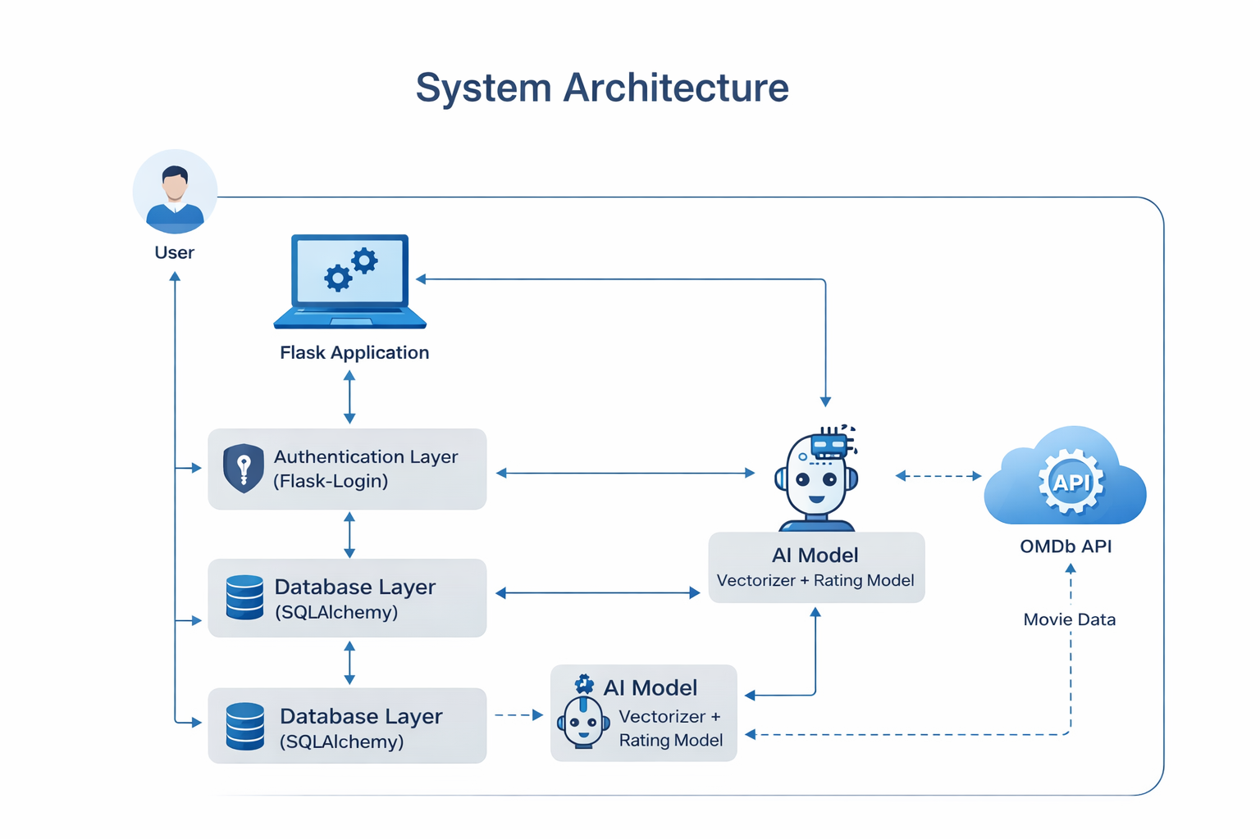

Slide 8
Module description
Auth Module: Secure Entry -Validates user credentials through a multi-layer authentication framework to initiate a secure session
AI Pipeline: Intelligent Processing -Converts raw user reviews into numerical vectors to be analysed and scored by specialized Machine Learning models.
Sync Engine: Data Enrichment -Retrieves real-time external metadata via the OMDb API and merges it with internal user data structures.
Persistence Module: Data Commitment - Utilizes the SQLAlchemy ORM to commit all processed scores, interactions, and metadata to the relational database.
Dashboard Module: Personalized Delivery -Renders the final processed data through a dynamic, Flask-based interface tailored to the individual user.

Slide 9
Advantages
Enhanced Data Accuracy & Context - By combining AI-driven sentiment analysis with real-time OMDb metadata
Enterprise-Grade Reliability -The use of a multi-layer authentication framework and SQL Alchemy ORM ensures that the application is not only secure against unauthorized access but also scalable and stable under heavy data loads.
Seamless Automation - The automated pipeline replaces manual data entry and analysis
Superior User Retention -The tailored user journeys and personalized dashboards create a sticky user experience
Scalable Architecture -The modular design allows for easy integration of additional ML models or external APIs in the future without disrupting the existing core infrastructure or database integrity.

Slide 10
Conclusions
Integrated Intelligence - The project successfully bridges the gap between complex Machine Learning models and user-friendly web interfaces, transforming raw data into meaningful, automated insights.
Security-First Architecture - By implementing a robust authentication framework, the platform ensures that high-performance data processing never comes at the cost of user privacy or data integrity.
Operational Efficiency - The automation of the AI pipeline and external API synchronization significantly reduces manual overhead, providing a scalable solution for real-time data enrichment.
Future-Ready Foundation - The modular design using Flask and SQLAlchemy provides a flexible baseline, allowing for the seamless addition of new data sources and advanced AI capabilities as requirements evolve.

Slide 11
Thank You

